Slide 1

Mepco Schlenk Engineering College (Autonomous)
23CS553 – Mini Project III
VAULTO-DO
S.Affrin (Reg.No. : 9517202304004)
R.Ilakkiya (Reg. No. : 9517202304052)
S.S.G.Krithigayogasri (Reg. No. :9517202304071)
Department of Computer Science and Engineering
1

Slide 2
Mepco Schlenk Engineering College (Autonomous)
Problem Description:
Concern over the absence of integrated solutions that combine productivity and personal data security is growing in a world where people heavily depend on digital tools to manage their daily activities. The majority of to-do list apps only manage tasks. Users must rely on other, frequently complicated tools to store private data. Convenience and confidentiality become incompatible as a result. A user-friendly platform that protects user’s private information while enabling them to maintain organization is obviously needed.
6 November 2025
6 November 2025
6 November 2025
6 November 2025
6 November 2025
6 November 2025
Department of Computer Science and Engineering
2

Slide 3
Mepco Schlenk Engineering College (Autonomous)
Objective:
To develop a dual-purpose web application by bridging the gap between productivity and privacy.
To design a clean to-do list interface that allows users to manage their tasks.
To implement a hidden “Vault Mode” that is accessible only through a master passcode.
To ensure that vault remains completely invisible within the user interface by enhancing the security with strong encryption techniques to store confidential files.
To provide a smooth and user-friendly experience.
6 November 2025
6 November 2025
Department of Computer Science and Engineering
3

Slide 4
Mepco Schlenk Engineering College (Autonomous)
OUTCOME:
A dual-purpose tool for privacy and productivity.
It offer users a user-friendly to-do list for everyday task management.
Along with is a hidden, secure vault for storing confidential data.
The vault will remain invisible until triggered by specific actions or inputs and accessed through a master passcode, ensuring data privacy.
Smooth user-friendly interface.
The final product will provide a simple, unified solution that enhances productivity while offering peace of mind through strong, user-controlled data protection.
6 November 2025
6 November 2025
6 November 2025
6 November 2025
6 November 2025
6 November 2025
6 November 2025
Department of Computer Science and Engineering
4

Slide 5
Mepco Schlenk Engineering College (Autonomous)
ARCHITECTURE DESIGN:
An architectural diagram implies the flow of the system. The flow starts whether the user has an account or not. If the user had an account, it directly takes to the login page and after he logged into the system, it enables the user to assign their important tasks in the to-do dashboard and also has a local file storage to store files .The user can access a secret vault by clicking the logo more than three times to store files encrypted and securely.
Department of Computer Science and Engineering
5

Slide 6
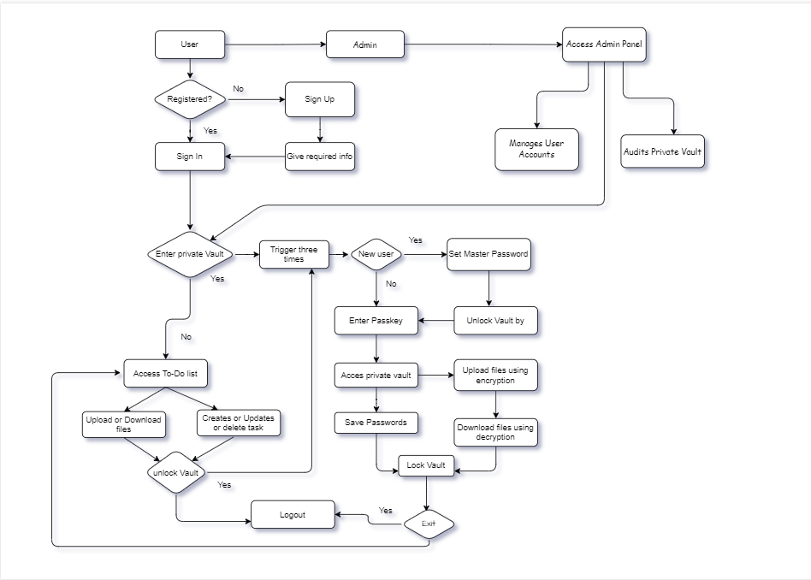
Mepco Schlenk Engineering College (Autonomous)
ARCHITECTURE DIAGRAM
6 November 2025
Department of Computer Science and Engineering
6

Slide 7
Mepco Schlenk Engineering College (Autonomous)
Modules: sample Module
Listed below gives a description of database document schemas used for the Medical Inventory Management System.
Inventory Description
User Description
Order Description
6 November 2025
6 November 2025
Department of Computer Science and Engineering
7

Slide 8
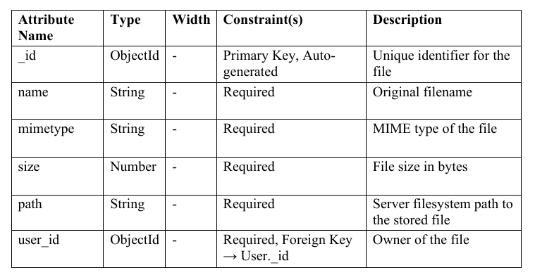
Mepco Schlenk Engineering College (Autonomous)
INVENTORY STRUCTURE:
sample
The inventory description has the attributes such as the name, id, quantity, amount, manufacture date and expiry date of the product.
6 November 2025
6 November 2025
Department of Computer Science and Engineering
8

Slide 9
Mepco Schlenk Engineering College (Autonomous)
sample
User Structure
Attribute Name | Type | Constraint(s) | Description
Name | String | Required | Name of the user
Email | String | Required | Mail id of the user
Password | String | Required | Password of the user
The user structure has the description required for the user and has the attributes such as the name, password and the email for the user.
6 November 2025
Department of Computer Science and Engineering
9

Slide 10
Mepco Schlenk Engineering College (Autonomous)
LOW LEVEL DESIGN
Login Details:
sample
Files used | Login.ts, login.html, login.css
Short Description | Allows the user to login to the application
Arguments | Username, Password
Return | Success/Failure in login
Pre-Condition | The user must have an account
Post-Condition | The home page will be displayed
Exception | Invalid username and password
Actor | Admin and users
6 November 2025
6 November 2025
Department of Computer Science and Engineering
10

Slide 11
Mepco Schlenk Engineering College (Autonomous)
SIGNUP DETAILS:
sample
Files used | Signup.ts, signup.html, signup.css
Short Description | Allows the user to signup to the application
Arguments | Username, Password,email
Return | Success/Failure in is signup
Pre-Condition | Anyone register in the application
Post-Condition | User registered successfully
Exception | Invalid email, username and password
Actor | Users
6 November 2025
6 November 2025
Department of Computer Science and Engineering
11

Slide 12
Mepco Schlenk Engineering College (Autonomous)
sample
Add Stock
Files used | Addstock.ts, Addstock.html, Addstock.css
Short Description | Allows the admin to Addstock to the application
Arguments | Name, quantity, Expiry date Manufacture date of the product
Return | Success/Failure in is insertion of the stock
Pre-Condition | The product must be unavailable.
Post-Condition | New product added successfully
Exception | Item already available
Actor | Admin
6 November 2025
6 November 2025
Department of Computer Science and Engineering
12

Slide 13
Mepco Schlenk Engineering College (Autonomous)
Update Stock
sample
Files used | Updatestock.ts, Updatestock.html, Updatestock.css
Short Description | Allows the admin to Updatestock to the application
Arguments | Name, quantity of the product
Return | Success/Failure in is updation of the stock
Pre-Condition | The product must be available.
Post-Condition | Product updated successfully
Exception | Item is unavailable
Actor | Admin
6 November 2025
6 November 2025
6 November 2025
Department of Computer Science and Engineering
13

Slide 14
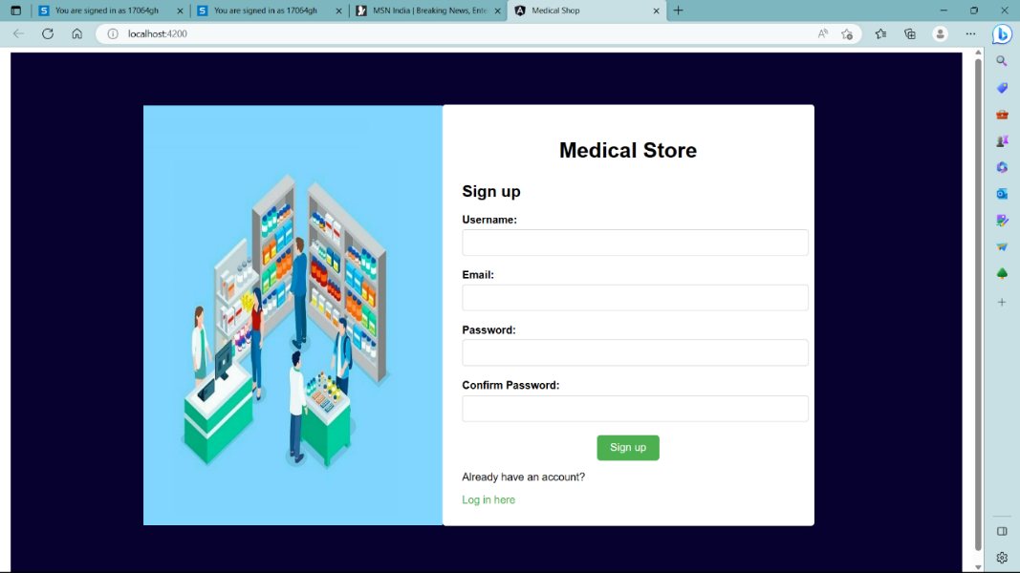
Mepco Schlenk Engineering College (Autonomous)
RESULTS:
SignUp Page
sample
6 November 2025
6 November 2025
6 November 2025
Department of Computer Science and Engineering
14

Slide 15
Mepco Schlenk Engineering College (Autonomous)
sample
This shows the Signup Page provide the interface for SignUp page of Medical Inventory Management System. The customers who are willing to purchase the products from the inventory must get themselves registered in the system. The customer must provide the username, password and the mail id for the registration. The email id must be a valid email id. The password and the confirm password must be the same. Now after clicking the signup button the user gets registered in the system.
6 November 2025
6 November 2025
6 November 2025
Department of Computer Science and Engineering
15

Slide 16
Mepco Schlenk Engineering College (Autonomous)
THANK YOU
6 November 2025
6 November 2025
6 November 2025
6 November 2025
6 November 2025
6 November 2025
6 November 2025
Department of Computer Science and Engineering
16

